Slide 1

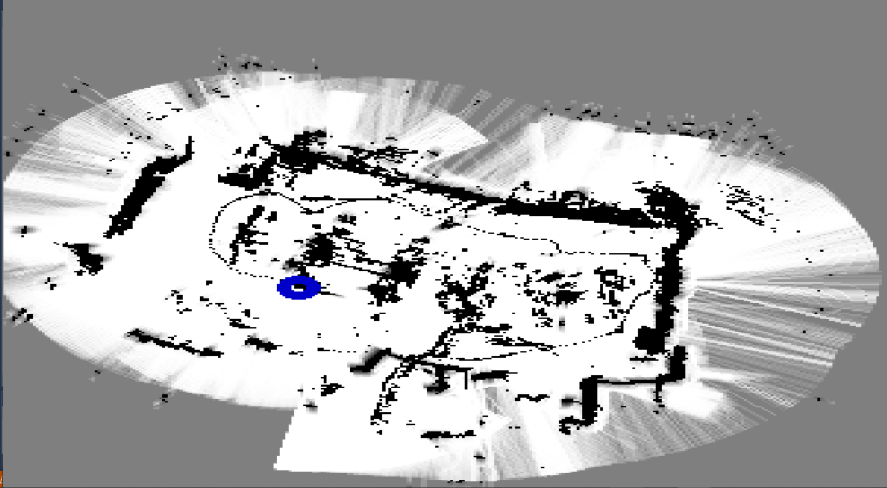
FPGA Implementation of LiDAR Terrain Mapping System based on High Level Synthesis
Student Name: Donal Conneely
Student Number: 15378661
Course: MECE Masters of Electronic & Computer Engineering
Academic Supervisor: Dr Fearghal Morgan
Co Assessor: Mr Liam Kilmartin
Technicians: Mr Myles Meehan & Mr Martin Burke

Slide 2
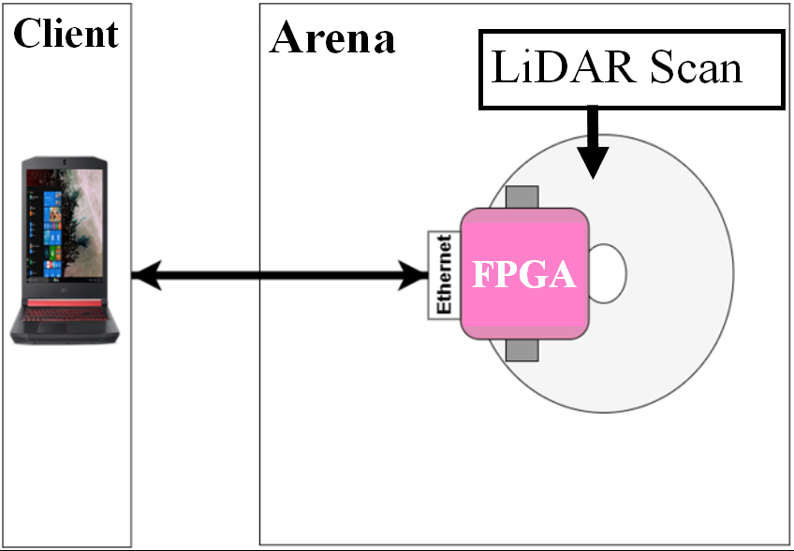
Purpose and Objectives
In today’s session will outline:
A brief summary of the project goals and description.
A brief overview of the project background.
A summary of High-Level Synthesis
An overview of the project functionality.
Detail areas of possible future expansion.
Notes:
The purpose of todays session is:
To provide you with a brief overview of my project and demonstrate a implementation of the project. The focus of this presentation will primarily be related to the background of the project and demonstration of the project.

Slide 3
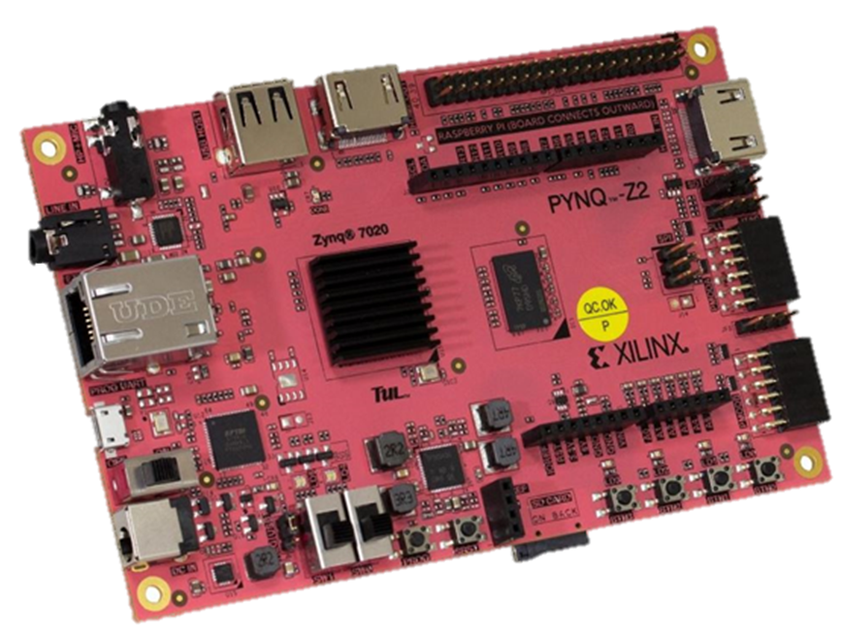
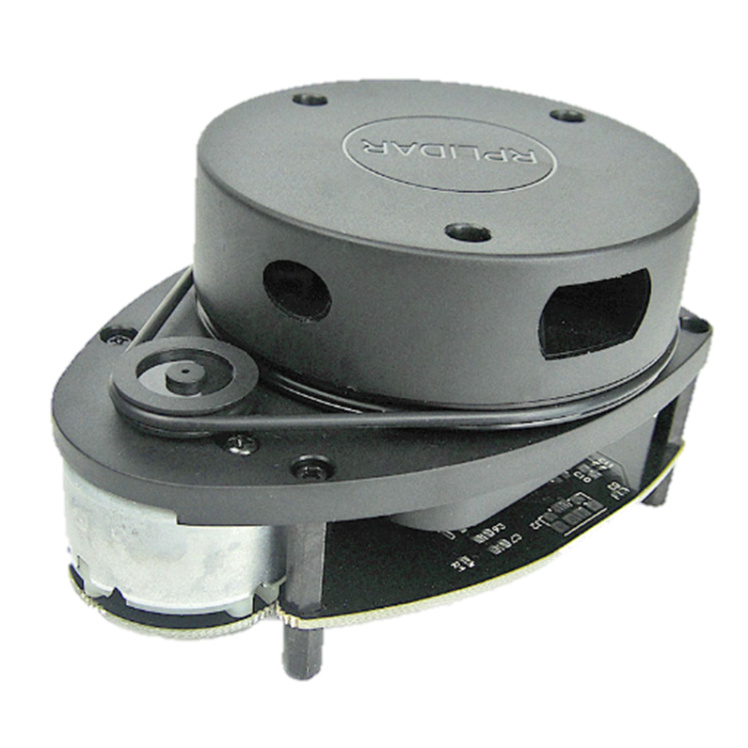
Project Description
The aim of this project is to demonstrate the capabilities of High Level-Synthesis (HLS), to encode complex systems onto FPGAs.
The system is based on a Simultaneous Localization And Mapping (SLAM) algorithm called tinySLAM.
TinySLAM is used to construct a map of the surrounding environment implemented through HLS on a Xilinx PYNQ-Z2 FPGA .
Notes:
The primary goal of this project is to show the capabilities of HLS, aswell as demonstrate the benefits of encoding onto an FPGA rather than a more standard microcontroller.

Slide 4
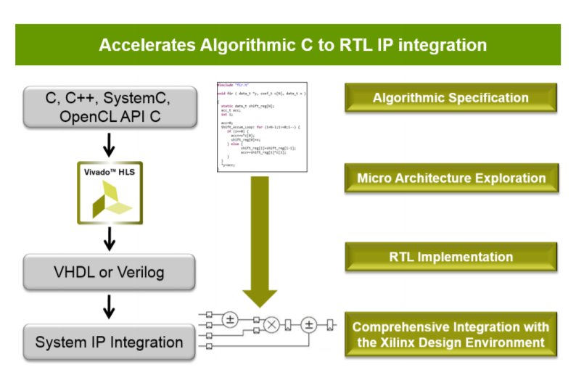
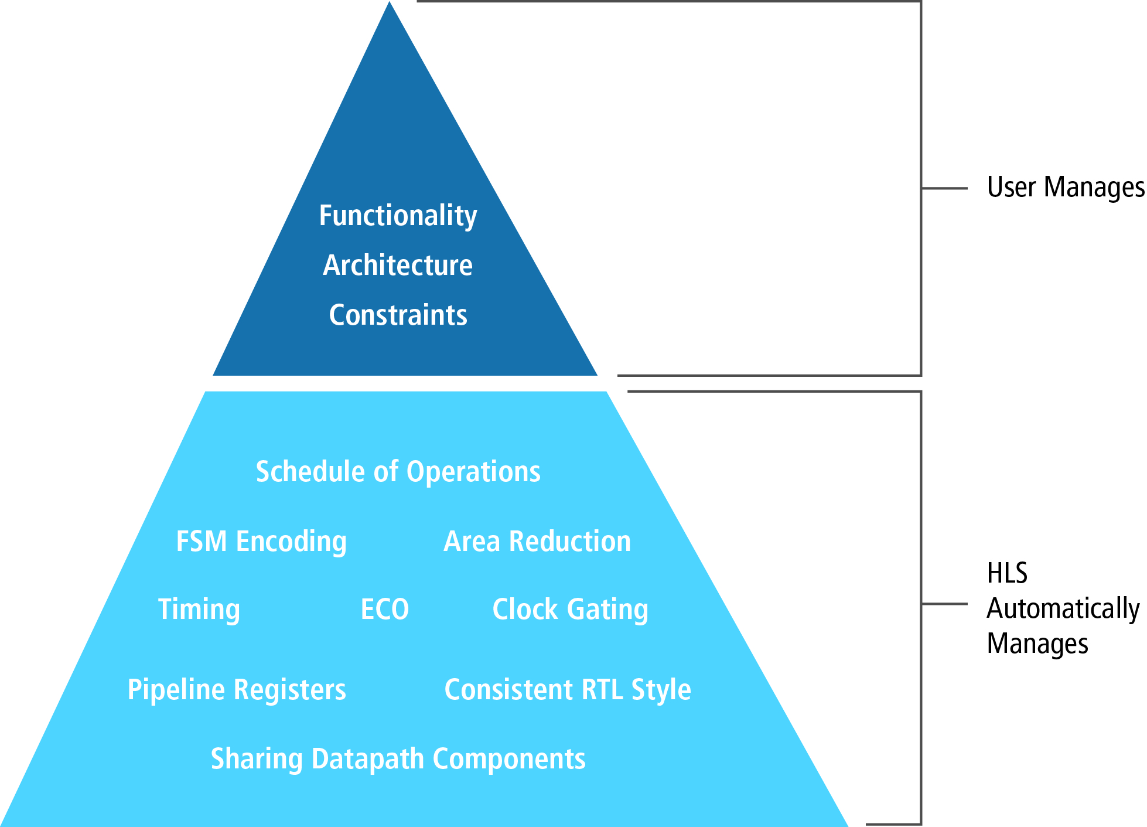
Project Background: High Level Synthesis (HLS)
High-Level Synthesis (HLS):
HLS is a method of parsing existing high-level programming languages, such as C/C++, into Hardware Description Languages (HDLs) used to program FPGAs.
HLS operates as a form of design automation, allowing the designer to focus on the specific application requirements instead of focusing on the specific requirements of the target platform.
Notes:
FPGAs are commonly programmed using Hardware Description Languages (HDLs), such as VHDL or Verilog.
HDLs allow for a high degree of system control; however, they are often very verbose and time-consuming.
Therefore a alternative was developed HLS
While this does reduce the customization potential of standard HDLs, it allows for the use of the FPGAs increased energy efficiency, without the time delays associated with converting an algorithm to an HDL by hand.

Slide 5
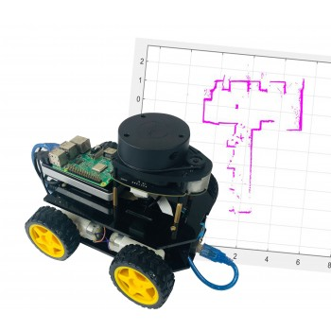
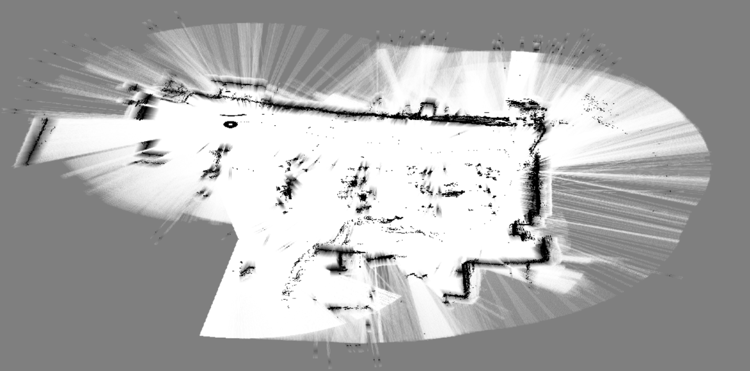
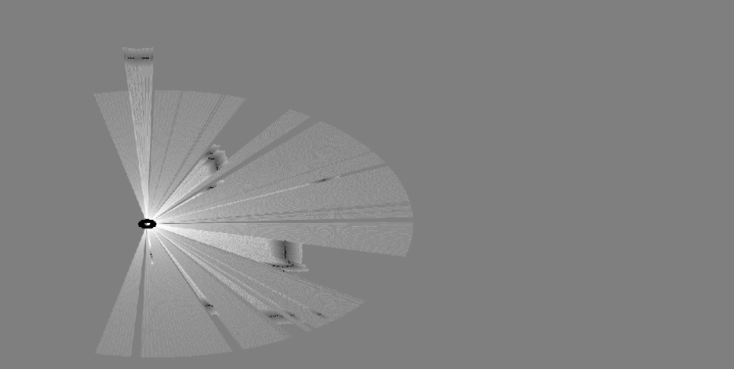
Project Background: Robotic Terrain Mapping
Terrain Mapping:
A specific application of computer vision systems.
Terrain mapping relates to the perception of the terrain an autonomous system would need to navigate.
Terrain Mapping is a method of recording the perceived terrain and using this data to construct a "map" of the perceived environment.
Notes:
Terrain Mapping System:
Over the course of the project many different versions of Terrain Mapping were considered:
1) Mean Shift Image Segmentation:
Cluster’s Pixels together and then calculates Terrain Based on the clusters.
Found unsuitable as Mean Shift Image Segmentation is designed for Terrain Perception but not mapping.
2) Simultaneous Localization And Mapping (SLAM):
Relates to the problem of constructing a map of an unknown environment while simultaneously keeping track of a system's location within said environment.
Multiple Variants: ORB-SLAM, FastSLAM, tinySLAM.

Slide 6
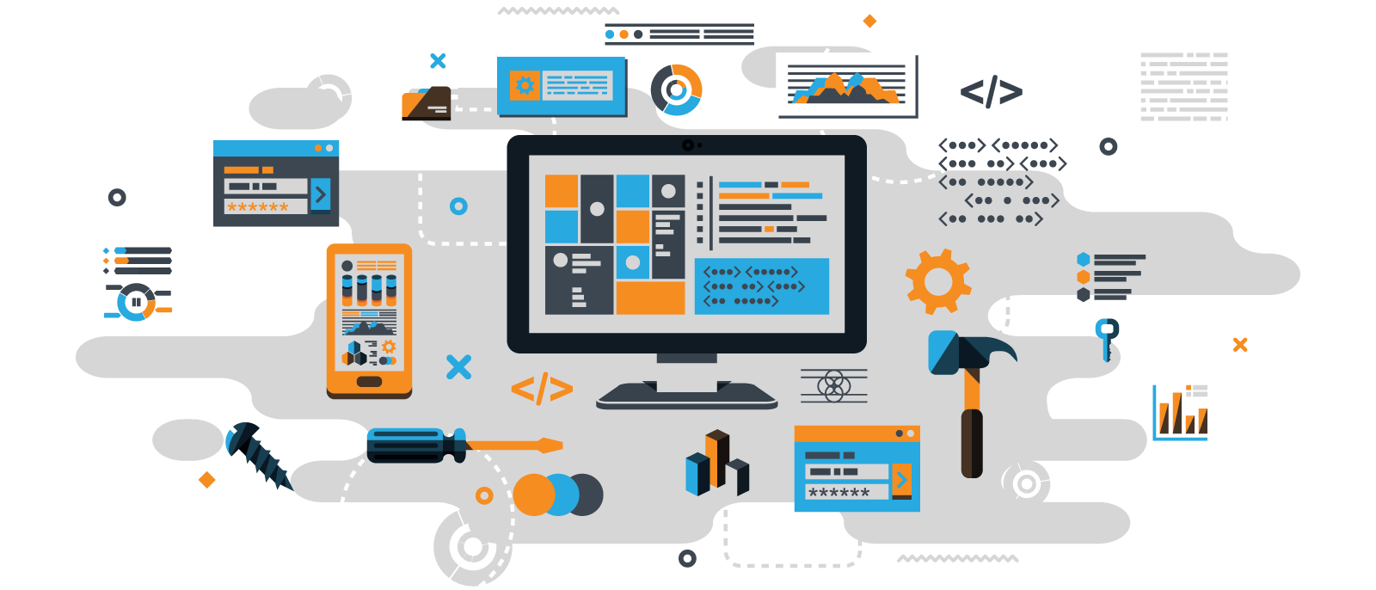
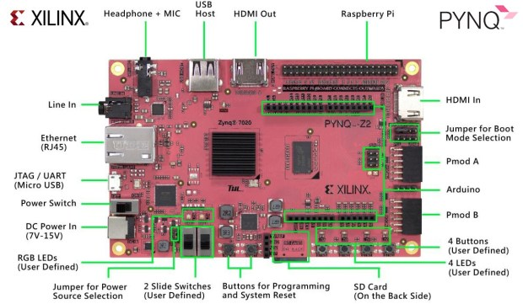
System Architecture
FPGA:
Utilises a Xilinx PYNQ-Z2.
The FPGA is broken into two parts the Processing System (PS) and the Programmable Logic (PL).
The PS is comprised of an ARM-Linux processor running a Python Script for the system and reading the scans from a external LiDAR.
The PL is where the IP Blocks constructed using HLS are stored. This part handles the majority of calculations.
External Client:
The external client of the project is an external system run on a Laptop/Desktop.
External client run on a Jupyter Notebooks Browser.
The external client allows the user to start/stop the scanning and displays the constructed map for the user.

Slide 7
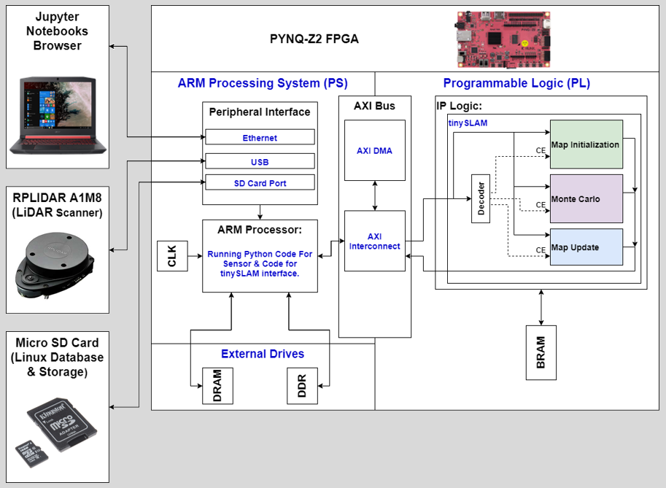
System Architecture (Diagram)

Slide 8


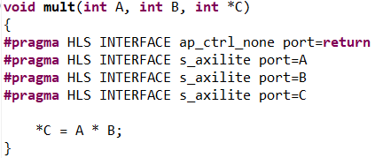
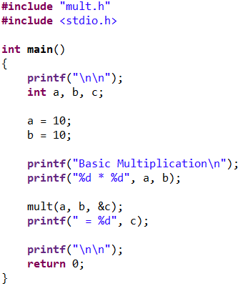
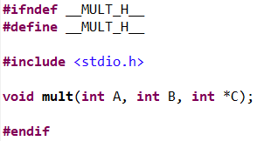
Project Methodology: High Level Synthesis (HLS)
High-Level Synthesis:
Vivado HLS the requires three files:
The Design File (.C or .CPP), which details the code for the desired application.
The Testbench File (.C or .CPP), which is used to test the functionality of the Designed system.
The Header File (.H), which acts as the link to match the Testbench to the Design File.
In order to communicate between the Processing System (PS) and the Programmable Logic (PL) of the FPGA the system must transfer across the AXI Bus. To use the AXI Bus the system must call the AXI pragma operations (This is an AXI-Lite Example).
Design File
Testbench File
Header File

Slide 9

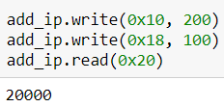
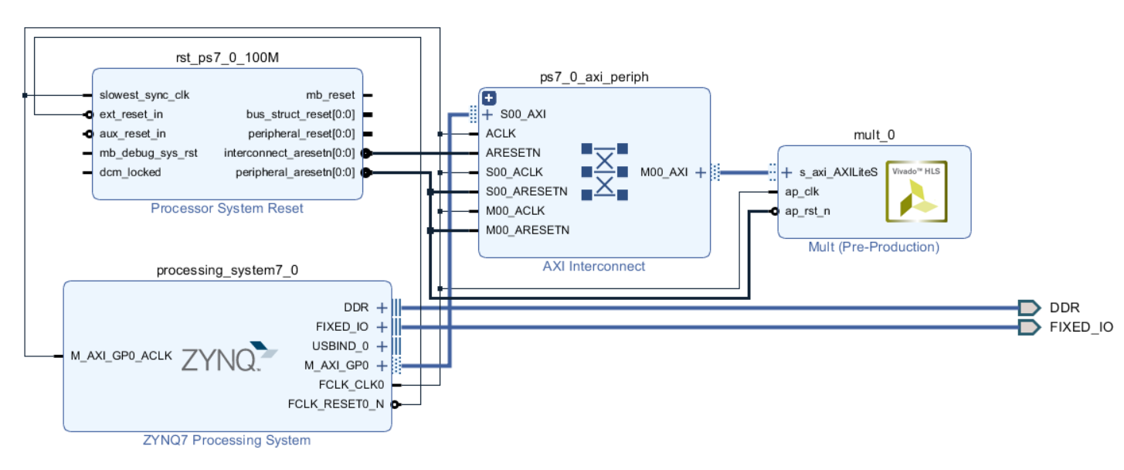
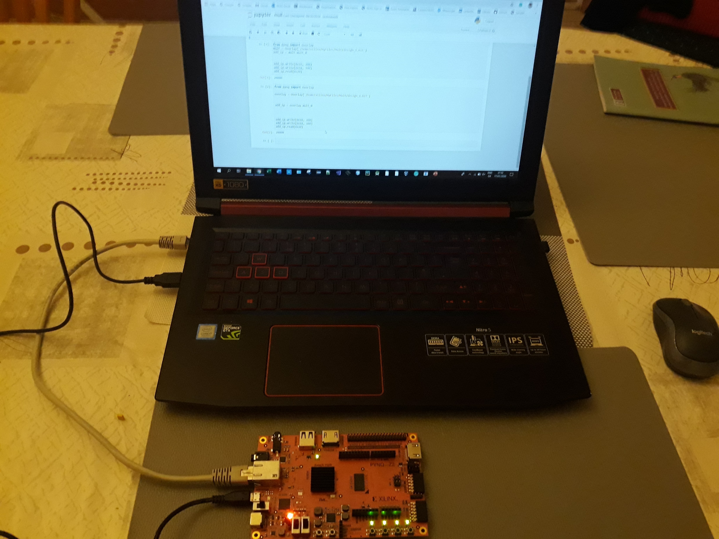
Project Methodology: High Level Synthesis (Cont..)
Once the IP for the design has been generated, the design must be opened in Vivado to generate the bitstream.
Once the Bitstream has been generated the design can be loaded onto the FPGA using the Jupyter Notebooks Client.
A = 200
B = 100
C = 20,000
Block Diagram

Slide 10
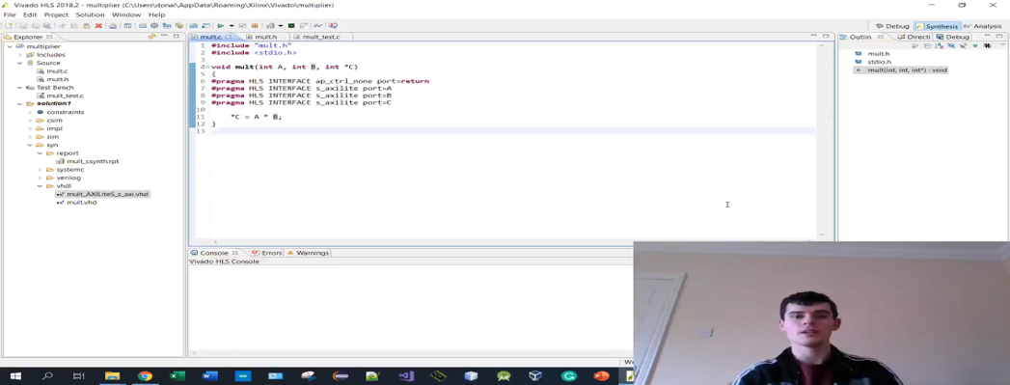
Project Methodology: High Level Synthesis (Video Demonstration)

Slide 11
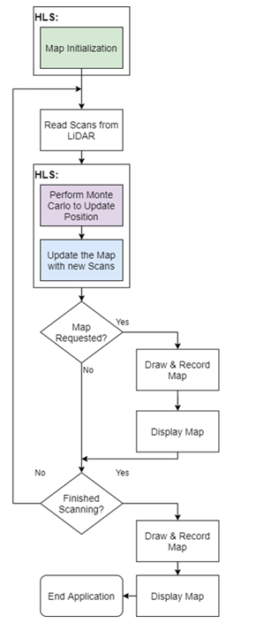
Project Methodology: Terrain Mapping System
The system is based on a Simultaneous Localization And Mapping (SLAM):
SLAM algorithms relate to the problem of constructing a map of an unknown environment while simultaneously calculating the system's location within said map, resulting in a “chicken-or-egg” scenario.
The tinySLAM algorithm is a low complexity implementation of SLAM designed for use on systems with limited resources.
The tinySLAM algorithm is a Laser based version of SLAM using LiDAR to scan for new elements of the map. The LiDAR used is a RPLIDAR A1M8.

Slide 12

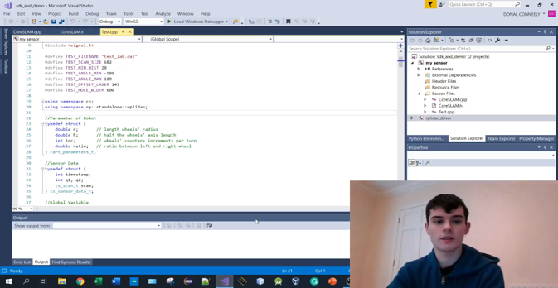
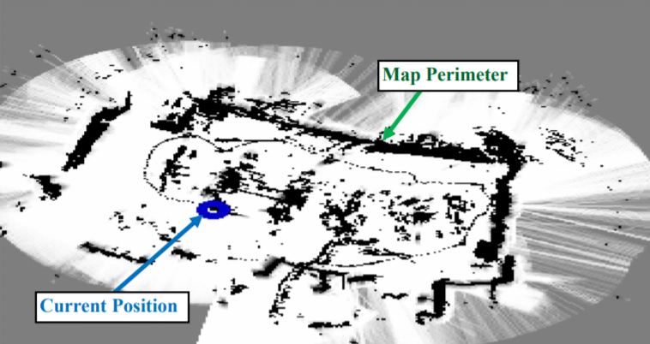
Project Methodology: Terrain Mapping System
C/C++ Version (on Acer Nitro 5 Laptop)

Slide 13
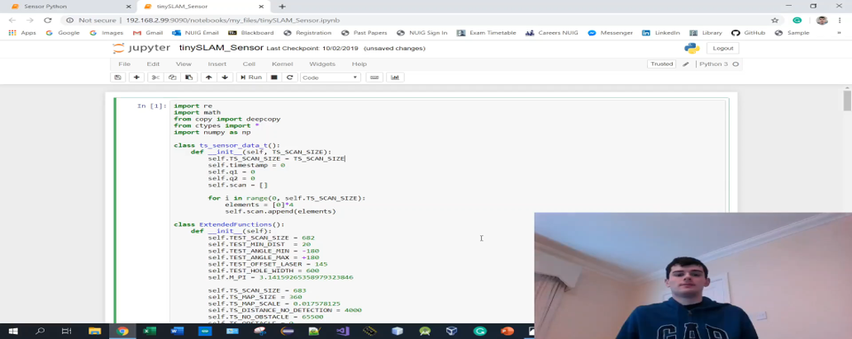
Finalised System Demonstration

Slide 14
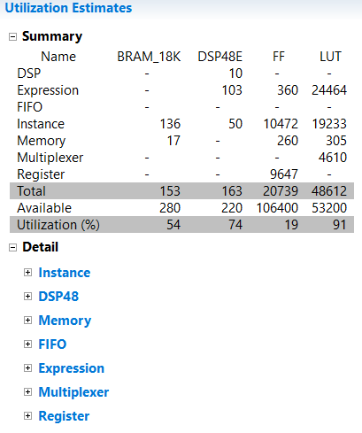
Conclusions
The system successfully mapped the same environment as the C/C++ and the Python Versions of the system.
The system was found to be much slower than the C/C++ implementation
However, the C/C++ implementation was run on the Acer Nitro 5 Laptop, while the HLS was run on a PYNQ-Z2 Board which is a much smaller and less powerful machine, which may account for the majority of the slow down.
The system however was found to be faster than the pure Python version.
Both the Python and the HLS version were run on the same board, and the HLS did communicate with a simplified Python Script.
Examining the HLS and Python system revealed some areas of potential improvement.
The HLS version has to constantly communicate back and forth between the PL and the PS of the board using the AXI, causing a degree of bottle-necking.
Notes:
One inefficiency of note of the system is that the movement of the system must be slow enough such that the Monte Carlo can accurately update the position without confusion. This error however is found across all versions and is not specific to the HLS implementation.

Slide 15
Future Expansion
In a real world scenario this project should be connected to an independent external client, as opposed to the current model which uses a Jupyter Notebooks browser.
This system could be made into a fully autonomous system by attaching the system to an autonomous robot.
The accuracy and speed of movement of the system could be increased by adding a secondary method of determining location such as GPS or an Odemetres.
The system could optimize the allocation of tasks between the PS (Python) and the PL (HLS IP) on the board to better optimize system speed.
Notes:
One inefficiency of note of the system is that the movement of the system must be slow enough such that the Monte Carlo can accurately update the position without confusion. This error however is found across all versions and is not specific to the HLS implementation.
Currently the system is designed to perform as much of the calculations on the PL side as possible. This can cause bottlenecking as the system must pass all the data back and forth across the AXI bus. Additionally this causes some slow-down on the HLS side in order for the system to handle the large resource usage.

Slide 16

Summary
In summary todays presentation went into detail about the current progress of the project:
A brief overview of the project background.
A brief explanation of the project description.
Analysis of the project in terms of High-Level Synthesis and the Terrain Mapping System

Slide 17

Thank You

